Slide 1

Data 603 – Big Data Platforms
Lecture 6
Structured APIs (Part 2)

Slide 2
Spark SQL Intro

Slide 3
Spark SQL
Allows developers to work with standard SQL (ANSI SQL:2003) to make queries on structured data with a schema
Introduced in Spark 1.3
Provides high-level structured functionalities for DataFrame and Dataset.
Unifies Spark components and simplifies working with structured data sets by providing abstractions for DataFrames/Datasets.
Connects to Apache Hive metastore and tables

Slide 4
Spark SQL
Reads and writes structured data with a specific schema from structured file formats (JSON, CSV, Text, Avro, Parquet, ORC, etc.) and converts data into temporary tables.
Connecting with external tools, including BI tools (Power BI, Tableau, SAS), via JDBC and ODBC
Optimization via Catalyst Optimizer and Project Tungsten.
These support high-level DataFrame, Dataset APIs and SQL queries.

Slide 5
Spark SQL
Spark Applications
JDBC/ODBC Connectors
DataFrames
Datasets
SQL Tables
Spark SQL
Parquet
CSV
JSON
S3/Azure Blob Storage

Slide 6
Catalyst Optimizer
Takes a computation query and converts it into an execution plan.
Four Transformational phases:
Phase 1: Analysis
Abstract Syntax Tree (AST) is generated for the SQL/DataFrame query
Any columns or table names will be resolved by consulting an internal Catalog which holds a list of names of columns, data types, functions, tables and databases
Phase 2: Logical Optimization
Construct a set of multiple plans and then, using its cost-based optimizer (CBO), assign costs to each plan which are laid out as operator trees
Logical plan becomes the input for the physical plan
Phase 3: Physical Planning
Selection of the optimal physical plan based on the logical plan
Phase 4: Code Generation
Project Tungsten facilitates whole-stage code generation to generate efficient Java bytecode.

Slide 7
Catalyst Optimizer
# In Python
count_mnm_df = (mnm_df
.select("State", "Color", "Count")
.groupBy("State", "Color")
.agg(sum("Count")
.alias("Total"))
.orderBy("Total", ascending=False))
-- In SQL
SELECT State, Color, sum(Count) AS Total
FROM MNM_TABLE_NAME
GROUP BY State, Color
ORDER BY Total DESC
The resulting byte code to compute above codes are likely the same.

Slide 8
Catalyst Optimizer
In Python, use explain(True) method on DataFrames to see the different stages the code goes through.
In Scala, call df.queryExecution.logical, or df.queryExecution.optimizedPlan

Slide 9
Tungsten Whole-stage Code Generation
Introduced in Spark 2.0
Physical query optimization phase
Collapses the whole query into a single function
Gets rid of virtual function calls and leverages CPU registers for intermediate data
Generates compact RDD code for final execution
Significantly improves CPU efficiency and performance

Slide 10
Spark SQL and DataFrames
SparkSesssion – unified entry point for programming Spark with the Structured APIs.
Provides sql() method for SQL queries
All SQL queries return a DataFrame
ANSI:2003-compliance SQL
Any DataFrame can be registered as a table or view (a temporary table) and query it using SQL.
No performance difference between using SQL or DataFrame API
Both compile to the same underlying plan specified in DataFrame code.

Slide 11
Spark Metastore
Stores metadata of tables in Spark
Information about the table and its data
The schema, description, table name, database name, column names, partitions, physical location where the actual data resides
Spark by default uses Apache Hive metastore
By default Located at /usr/hive/warehouse
Persist all the metadata about the tables
The default location can be changed using config variable spark.sql.warehouse.dir

Slide 12
SparkSession.catalog
Metadata is captured in the Catalog
A high-level abstraction in Spark SQL for storing metadata
Functionality was expanded in Spark 2.x with new public methods providing ability to examine the metadata associated with the databases, tables and views.
Spark 3.0 extends it to use external catalogs.
spark.catalog.listDatabases()
spark.catalog.listTables()
spark.catalog.listColumns("us_delay_flights_tbl")
For the list of available methods, refer here

Slide 13
Managed vs. Unmanaged Tables
Two types of tables can be created:
Managed
Spark manages both the metadata and the data in the file store (local filesystem, HDFS, an object store such as AWS S3, or Azure Blob Storage)
DROP TABLE command deletes both the metadata and the data
CREATE TABLE <example-table>(id STRING, value STRING)
Unmanaged
Spark only manages the metadata
External data is managed outside of Spark.
DROP TABLE command only deletes the metadata.
CREATE TABLE <example-table>(id STRING, value STRING) USING org.apache.spark.sql.parquet OPTIONS (PATH "<your-storage-path>")

Slide 14
Creating SQL Databases and Tables
# In Scala/Python
spark.sql("CREATE DATABASE database_name")
spark.sql("USE database_name")
# Creating managed table
spark.sql("CREATE TABLE managed_us_delay_flights_tbl (date STRING, delay INT, distance INT, origin STRING, destination STRING)")
# Or using the DataFrame API
csv_file = "/databricks-datasets/learning-spark-v2/flights/departuredelays.csv"
schema="date STRING, delay INT, distance INT, origin STRING, destination STRING"
flights_df = spark.read.csv(csv_file, schema=schema)
flights_df.write.saveAsTable("managed_us_delay_flights_tbl")
Tables reside within a database
By default Spark creates tables under the default database.

Slide 15
Creating SQL Databases and Tables
# Creating an unmanaged table
spark.sql("""CREATE TABLE us_delay_flights_tbl(date STRING, delay INT,
distance INT, origin STRING, destination STRING)
USING csv OPTIONS (PATH
'/databricks-datasets/learning-spark-v2/flights/departuredelays.csv')""")
Unmanaged tables are created from existing data sources

Slide 16
Views
Session Scoped (Temporary View)
df.createOrReplaceTempView(”temp_view_name")
Visible only to a single SparkSession
Disappears if the session that creates it terminates.
Global Views (Global Temporary View)
df.createGlobalTempView(”global_temp_view_name")
Shared among all sessions and keep alive until the Spark application terminates
Tied to a system preserved database global_temp
Must use the qualified name to refer it: e.g. SELECT * FROM global_temp.global_temp_view_name

Slide 17
Views
Views are temporary (both session-scoped and global). They disappear when the Spark application terminates
Built on top of tables. Views don’t hold data
When accessing a global temporary view, prefix global_temp.<view_name> must be used
Spark creates global temporary views in a global temporary database called global_temp
Normal temporary view (session scoped) can be accessed without the global_temp prefix.

Slide 18
Creating Views
-- In SQL
CREATE OR REPLACE GLOBAL TEMP VIEW us_origin_airport_SFO_global_tmp_view AS
SELECT date, delay, origin, destination from us_delay_flights_tbl WHERE
origin = 'SFO';
CREATE OR REPLACE TEMP VIEW us_origin_airport_JFK_tmp_view AS
SELECT date, delay, origin, destination from us_delay_flights_tbl WHERE
origin = 'JFK’;
# In Python
df_sfo = spark.sql("SELECT date, delay, origin, destination FROM us_delay_flights_tbl WHERE origin = 'SFO'")
df_jfk = spark.sql("SELECT date, delay, origin, destination FROM us_delay_flights_tbl WHERE origin = 'JFK’”)
Spark.sql(“select * from df_sfo
# Create a temporary and global temporary view
df_sfo.createOrReplaceGlobalTempView("us_origin_airport_SFO_global_tmp_view")
df_jfk.createOrReplaceTempView("us_origin_airport_JFK_tmp_view")

Slide 19
Dropping Views
-- In SQL
DROP VIEW IF EXISTS us_origin_airport_SFO_global_tmp_view;
DROP VIEW IF EXISTS us_origin_airport_JFK_tmp_view
# In Scala/Python
spark.catalog.dropGlobalTempView("us_origin_airport_SFO_global_tmp_view")
spark.catalog.dropTempView("us_origin_airport_JFK_tmp_view")

Slide 20
Caching SQL Tables
SQL tables and views can be cached and uncached.
In Spark 3.0, a table can be specified as LAZY - it should only be cached when it is first used instead of immediately.
CACHE [LAZY] TABLE <table-name>
UNCACHE TABLE <table-name>

Slide 21
Reading Tables in DataFrames
# In Python
us_flights_df = spark.sql("SELECT * FROM us_delay_flights_tbl")
us_flights_df2 = spark.table("us_delay_flights_tbl")

Slide 22
Data Sources for DataFrames and SQL Tables

Slide 23
DataFrameReader
Core construct for reading data from a data source into a DataFrame
Defined format and recommended pattern for usage:
DataFrameReader.format(args).option("key", "value").schema(args).load()
DataFrameReader can only be accessed through a SparkSession instance.
DataFrameReader instances cannot be created.
Getting an instance: SparkSession.read
No schema is required when reading from a static Parquet data source
The Parquet metadata usually contains the schema, so it’s inferred.
For streaming data source it is required to have the schema provided.

Slide 24
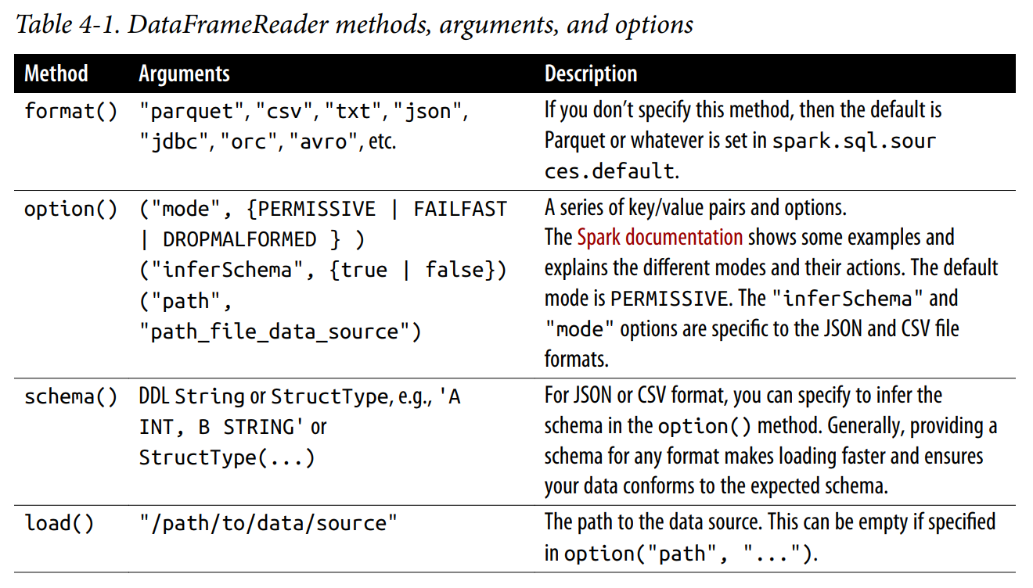
DataFrameReader
From: Learning Spark, 2nd Ed., Damji

Slide 25
DataFrameWriter
Unlike with DataFrameReader, an instance of DataFrameWriter is accessed from the DataFrame to be saved - not from a SparkSession.
DataFrameWriter.format(args)
.option(args)
.bucketBy(args)
.partitionBy(args)
.save(path)
# Getting an instance
DataFrame.write

Slide 26
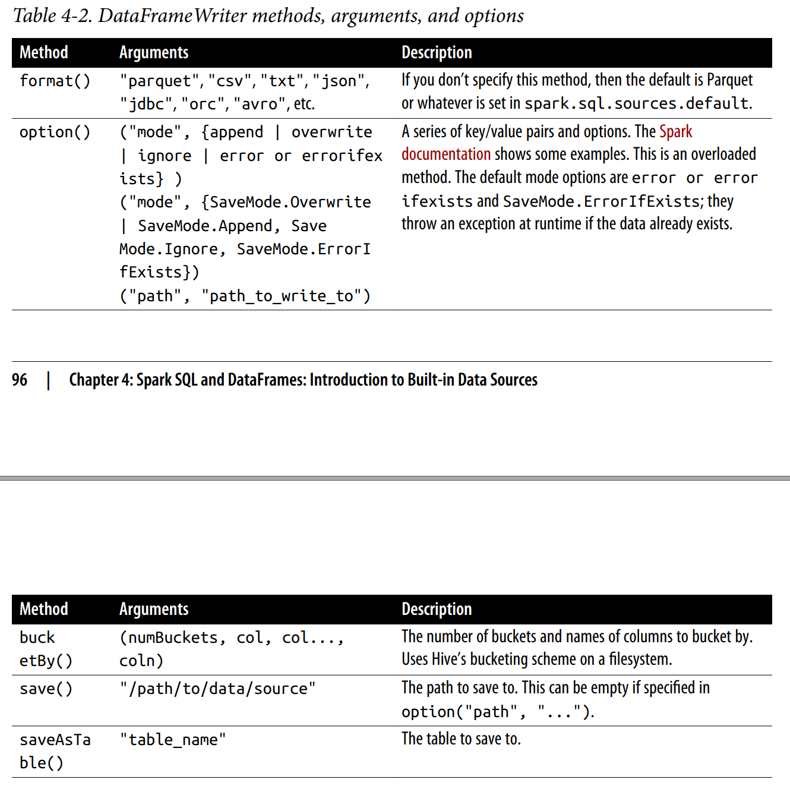
DataFrameWriter
From: Learning Spark, 2nd Ed., Damji

Slide 27
Parquet
Default data source in Spark
Supported and widely used by many big data processing frameworks
Open source columnar file format that offers many I/O optimizations such as compression
Stored in a directory structure containing the data files, metadata, a number of compressed files and status files

Slide 28
Parquet
-- In SQL
CREATE OR REPLACE TEMPORARY VIEW us_delay_flights_tbl
USING parquet
OPTIONS (
path "/databricks-datasets/learning-spark-v2/flights/summary-data/parquet/
2010-summary.parquet/" )
# Reading from a Parquet file in Python
spark.sql("SELECT * FROM us_delay_flights_tbl").show()
# Writing out to a Parquet file in Python
(df.write.format("parquet")
.mode("overwrite")
.option("compression", "snappy")
.save("/tmp/data/parquet/df_parquet"))
# Writing out to a table in Python
(df.write
.mode("overwrite")
.saveAsTable("us_delay_flights_tbl"))

Slide 29
JSON
Popular file format due to its ease of use.
Two representational formats:
Single-line mode
Each line denotes a single JSON object
multiline option set to False
multi-line mode
Entire multiline object constitutes a single JSON object
multiline option set to True

Slide 30
JSON
# In Python
file = "/databricks-datasets/learning-spark-v2/flights/summary-data/json/*"
df = spark.read.format("json").load(file)
-- In SQL
CREATE OR REPLACE TEMPORARY VIEW us_delay_flights_tbl
USING json
OPTIONS (
path "/databricks-datasets/learning-spark-v2/flights/summary-data/json/*"
)
# In Python
(df.write.format("json")
.mode("overwrite")
.option("compression", "snappy")
.save("/tmp/data/json/df_json"))

Slide 31
User Defined Functions (UDF)
https://docs.databricks.com/spark/latest/spark-sql/udf-python.html

Slide 32
User Defined Function (UDF)
Spark allows for data engineers and data scientists to define their own functions called user-defined functions (UDFs).
Data scientist can wrap an ML model within a UDF so that a data analyst can query its predictions in Spark SQL.
UDFs operate per session and they will not be persisted in the underlying metastore.

Slide 33
User Defined Function (UDF)
Issues with PySpark UDFs: they were slower than Scala UDFs.
Data had to be moved between JVM and Python.
PySpark UDF vs. Pandas (vectorized) UDF
A pandas user-defined function (UDF)—also known as vectorized UDF—is a user-defined function that uses Apache Arrow to transfer data and pandas to work with the data.
Pandas UDFs allow vectorized operations that can increase performance up to 100x compared to row-at-a-time Python UDFs.
References
https://docs.databricks.com/spark/latest/spark-sql/udf-python-pandas.html
https://databricks.com/blog/2020/05/20/new-pandas-udfs-and-python-type-hints-in-the-upcoming-release-of-apache-spark-3-0.html
https://docs.databricks.com/spark/latest/spark-sql/spark-pandas.html

Slide 34
User Defined Function (UDF)
Pandas UDFs (vectorized UDFs) were introduced in Apache Spark 2.3.
https://databricks.com/blog/2017/10/30/introducing-vectorized-udfs-for-pyspark.html
A Pandas UDF is defined using the keyword pandas_udf as the decorator, or to wrap the function itself.
Once the data is in Apache Arrow format, there is no longer the need to serialize/pickle the data as it is already in a format consumable by the Python process. Instead of operating on individual inputs row by row, you are operating on a Pandas Series or DataFrame (i.e., vectorized execution).

Slide 35
User Defined Function (UDF)
Apache Spark 3.0 with Python 3.6 and above, Pandas UDFs are split into two API categories:
Pandas UDFs
Pandas UDFs infer the Pandas UDF type from Python type hints in Pandas UDFs such as pandas.Series, pandas.DataFrame, Tuple, and Iterator.
Pandas Function APIs
Allows users to directly apply a local Python function to a PySpark DataFrame where both the input and output are Pandas instances.

Slide 36
External Data Sources
JDBC and SQL Databases - Using the data source API, the tables from the remote database can be loaded as a DataFrame or Spark SQL temporary view.
Partitioning of the data source
Required for large amount of data between Spark SQL and a JDBC external source
All data goes through one driver connection
numPartitions, use a multiple of the number of Spark workers.
Need to consider how well the source system can handle the read requests. It is possible to saturate the source system.

Slide 37
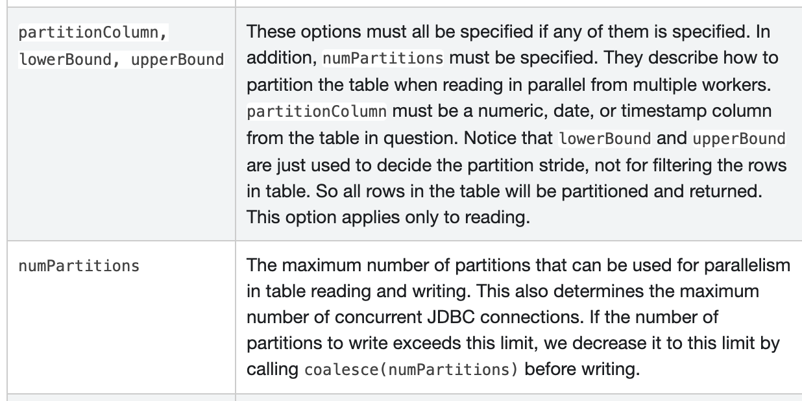
External Data Sources
https://spark.apache.org/docs/latest/sql-data-sources-jdbc.html
https://docs.databricks.com/data/data-sources/sql-databases.html#manage-parallelism

Slide 38
Higher-Order Functions

Slide 39
Complex Data Types
Before Spark 2.4, two typical solutions for manipulating complex data types:
Exploding the nested structure into individual rows, applying some function, and then re-creating the nested structure (using EXPLODE() and collect_list())
As values could be any number of dimensions (a really wide and/or really long array) and we’re doing a GROUP BY, (shuffle operation) this approach could be very expensive.
collect_list() may cause executors to experience out-of-memory issues for large data sets.
Utility functions: get_json_object(), from_json(), to_json(), explode(), and selectExpr().
Building a user-defined function
The serialization and deserialization process may be expensive.
UDFs do not have the out-of-memory issues that collect_list() may run into.
Better Approach: Use built-in functions for Complex Data Types
* Complex data types are nested data structures composed of simple data types (primitives)

Slide 40
The Best Approach: Higher-Order Functions
Higher-order functions take lambda functions as arguments.
They allow users to efficiently create functions, in SQL, to manipulate array based data.
A simple extension to SQL to manipulate nested data such as arrays

Slide 41
Lab: Higher-Order Functions
https://docs.databricks.com/_static/notebooks/higher-order-functions.html

Slide 42
Common DataFrames and Spark SQL Operations
Aggregate functions
Collection functions
Datetime functions
Math functions
Miscellaneous functions
Non-aggregate functions
Sorting functions
String functions
UDF functions
Window functions
https://spark.apache.org/docs/latest/sql-ref-functions-builtin.html

Slide 43
Window Functions
Aggregate Function vs. Window Functions
Aggregate functions take a group of rows and output a single value for them
Window functions allow keeping the individual rows as well as gaining a summarized value.
All aggregate functions can be used as window functions

Slide 44
Window Functions
PARTITION BY works like GROUP BY. It divides the dataset into multiple groups
For each group a window is created
When ORDER BY is not specified, the window is the entire group
When ORDER BY is specified, the rows in the group are ordered according to it, and a window is created for each row over which a function is applied.
When window is not specified, by default a window is created from every rows.
PARTITION BY groups, ORDER BY creates windows
SELECT columns,
window_function OVER (PARTITION BY partition_key ORDER BY order_key)
FROM table

Slide 45
Window Functions
 | SQL | DataFrame API
Ranking functions | rank | rank
 | dense_rank | denseRank
 | percent_rank | percentRank
 | ntile | ntile
 | row_number | rowNumber
Analytic functions | cume_dist | cumeDist
 | first_value | firstValue
 | last_value | lastValue
 | lag | lag
 | lead | lead

Slide 46
Window Functions
Additional references:
https://jaceklaskowski.gitbooks.io/mastering-spark-sql/content/spark-sql-functions-windows.html
https://medium.com/expedia-group-tech/deep-dive-into-apache-spark-window-functions-7b4e39ad3c86

Slide 47

Questions

Slide 48
Homework
https://docs.databricks.com/getting-started/spark/dataframes.html

